Slide 1




Blinkit
SALES PERFORMANCE ANALYSIS
Introduction to Blinkit
Blinkit is an online grocery delivery platform known for providing a wide variety of essential grocery and household items with fast delivery times. It serves millions of customers, making data insights into sales performance crucial for identifying trends, optimizing inventory, and improving customer satisfaction.
Project Overview
This Sales Performance Analysis Dashboard is designed to analyze Blinkit’s sales data to uncover key trends, sales metrics, and actionable insights. The primary objectives are to assess overall sales performance, understand customer purchase behavior, and provide a foundation for strategic decision-making.

Slide 2
Blinkit
SALES PERFORMANCE ANALYSIS
Steps in this Project
✓ Requirement Gathering/ Business Requirements
✓ Data Walkthrough
✓ Data Connection
✓ Data Cleaning / Quality Check
✓ Data Modelling
✓ Data Processing
✓ DAX Calculations
✓ Dashboard Lay outing
✓ Charts Development and Formatting
✓ Dashboard / Report Development
✓ Insights Generation

Slide 3
Blinkit
SALES PERFORMANCE ANALYSIS
Business Requirements
To conduct a comprehensive analysis of Blinkit's sales performance, customer satisfaction, and inventory distribution to identify key insights and opportunities for optimization using various KPIs and visualizations in Power Bl.
KPI’S Requirements
Total Sales: The overall revenue generated from all items sold.
Average Sales: The average revenue per sale.
Number of Items: The total count of different items sold.
Average Rating: The average customer rating for items sold.

Slide 4
Blinkit
SALES PERFORMANCE ANALYSIS
Chart Requirements
1. Total Sales by Fat Content:
Objective: Analyze the impact of fat content on total sales.
Additional KPI Metrics: Assess how other KPIs (Average Sales, Number of Items, Average Rating) vary with fat content.
Chart Type: Donut Chart.
2. Total Sales by Item Type:
Objective: Identify the performance of different item types in terms of total sales.
Additional KPI Metrics: Assess how other KPIs (Average Sales, Number of Items, Average Rating) vary with fat content.
Chart Type: Bar Chart.
3. Fat Content by Outlet for Total Sales:
Objective: Compare total sales across different outlets segmented by fat content.
Additional KPI Metrics: Assess how other KPIs (Average Sales, Number of Items, Average Rating) vary with fat content.
Chart Type: Stacked Column Chart.
3. Total Sales by Outlet Establishment:
Objective: Evaluate how the age or type of outlet establishment influences total sales.
Chart Type: Line Chart.

Slide 5
Blinkit
SALES PERFORMANCE ANALYSIS
Chart Requirements
5. Sales by Outlet Size:
Objective: Analyze the correlation between outlet size and total sales.
Chart Type: Donut/Pie Chart.
6. Sales by Outlet Location:
Objective: Assess the geographic distribution of sales across different locations.
Chart Type: Funnel Map.
7. All Metrics by Outlet Type:
Objective: Provide a comprehensive view of all key metrics (Total Sales, Average Sales, Number of Items, Average Rating)
broken down by different outlet types.
Chart Type: Matrix Card.

Slide 6

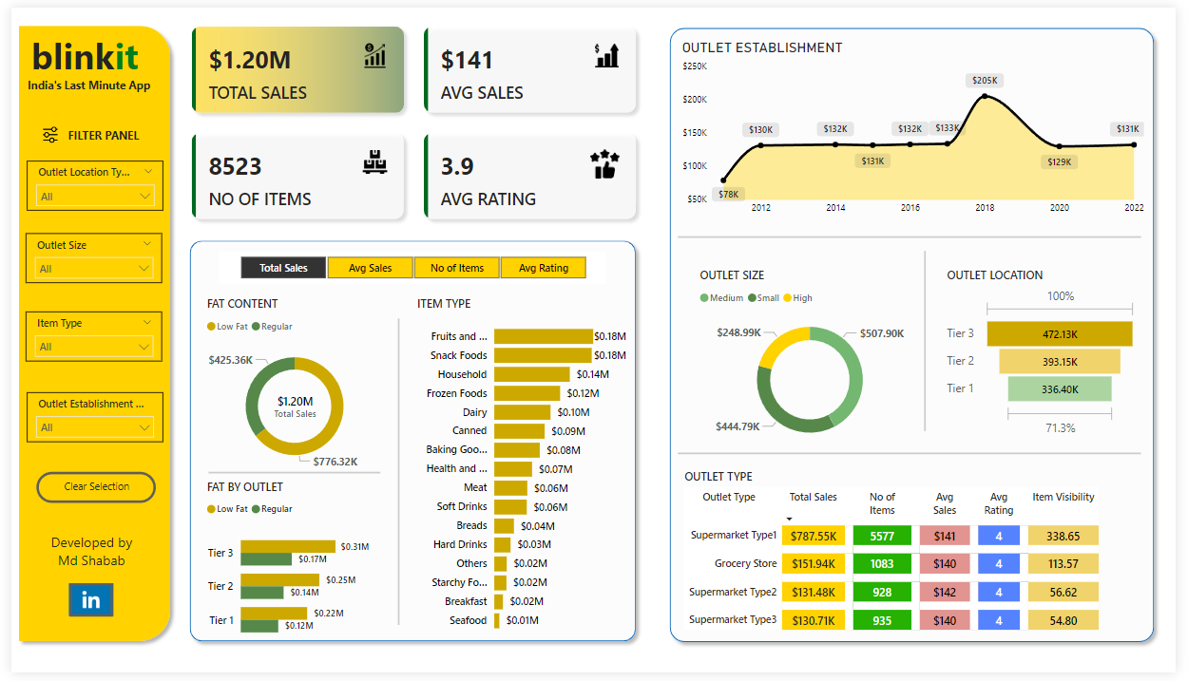
SALES PERFORMANCE ANALYSIS

Slide 7
Blinkit
SALES PERFORMANCE ANALYSIS
Top-Selling Item Categories: Certain item types, like "Fruits and Vegetables" and "Frozen Foods," appear as high performers in terms of sales, indicating customer preferences for fresh and frozen essentials.
Sales by Outlet Type: Supermarket Type1 outlets consistently generate higher sales compared to Type2, possibly due to better item variety or customer footfall in these locations.
Impact of Outlet Location: Outlets in Tier 1 locations outperform others in terms of sales, suggesting a strong market in more affluent or densely populated areas.
Item Fat Content Influence: Items labeled "Low Fat" show a notable sales trend, indicating a shift in customer preference toward healthier options.
Item Visibility and Sales Correlation: Higher visibility items (those with low 'Item Visibility' scores) tend to have higher sales, showing the importance of product placement in driving sales.
Outlet Size and Performance: Medium-sized outlets report more consistent sales, balancing inventory and space effectively, while smaller outlets may face limitations in stocking high-demand items.

Slide 8
Blinkit
SALES PERFORMANCE ANALYSIS
Sales Trends by Year of Establishment: Newer outlets (established after 2018) have slightly lower sales, potentially due to building customer base, while older outlets perform better, benefiting from established brand presence.
Average Weight Impact: Heavier items (typically bulk purchases) appear in customer carts more frequently, suggesting bulk shopping behavior, especially in larger outlets.
Sales Performance by Rating: Items with higher customer ratings show a clear sales increase, affirming the role of customer feedback in driving purchasing behavior.
Seasonal Sales Fluctuations: Preliminary data indicates sales spikes in specific months, suggesting the influence of seasonal trends or promotional events on purchasing patterns.
These insights highlight purchasing trends, outlet dynamics, and factors influencing customer choices, allowing Blinkit to strategize effectively around sales performance and customer engagement.

